Slide 1
Strengthening Access to Care During the PHE Through Telehealth and Provider Technological Supports
September 9, 2020
Department of Health Care Finance

Slide 2
Overview
Telehealth
New CMS HITECH Funding
DC HIE
SUD Provider Capacity Grant
Next Steps

Slide 3
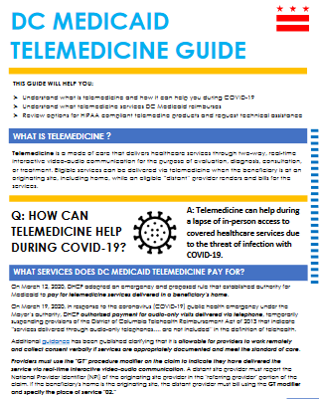
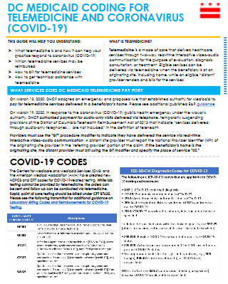
DHCF Telemedicine Final Rule
Allows Medicaid to pay for services via telemedicine if
Already included in the DHCF fee schedule within broad categories specified in the DHCF telemedicine rule, and
Can be delivered at the standard of care
Allows patient’s home as an originating site
Clarifies telemedicine is applicable to both FFS and MCO program
Providers have flexibility to work remotely
https://dhcf.dc.gov/page/telemedicine

Slide 4
Telemedicine Guidance During the PHE
Special Authorization during the public health emergency (PHE): | Issues to consider after the PHE:
Audio-only telemedicine services | District legislation defining telemedicine Telehealth must be HIPAA compliant per security rule
Document required telehealth consent in clinical notes | Will need formal documentation and signature of consent to be HIPAA compliant * Consent management system being developed for the DC HIE may be able to address
Flexibilities on using non-HIPAA compliant technology (e.g. Facetime) | Must be HIPAA compliant, including BAA agreements

Slide 5
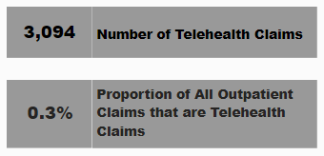
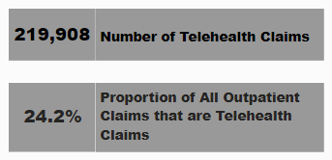
Telehealth Utilization Now Accounts for a Quarter of DHCF’s Outpatient Claims
In January and February 2020, telehealth accounted for just 0.3% of outpatient claims and only 0.8% of beneficiaries had a telehealth service
In April and May 2020, telehealth claims accounted for 24% of all DHCF outpatient claims and 20% of DHCF beneficiaries received a telehealth service
In April and May 2020, behavioral health services accounted for 68% of telehealth claims
Monthly Claim & Beneficiary Count (October 2019 – May 2020)
January – February 2020
April – May 2020
Source: DHCF Medicaid Management Information System (MMIS) data extracted on 8/31/2020. Note: Includes Medicaid, Alliance, and ICP. Reflects paid fee-for service claims and managed care organization encounters by date of service. Due to claims lag, counts for each month are likely to be higher when run at a future date.

Slide 6
CMS Approved DHCF Emergency Request to Support Health IT/Telehealth
Building on feedback from the community, DHCF developed an emergency request to CMS for HITECH enhanced match (90/10 FFP) to further support telehealth efforts in the District in a continued effort to combat coronavirus (COVID-19)
On July 9, 2020 CMS officially approved the District’s Emergency request for a total of $1,248,449 FFP to:
Purchase and loan laptops/tablets + data plans to providers with limited technical capabilities
Distribute HIPAA compliant telehealth platform licenses to providers without a license, and
Assist our DDS colleagues with upgrading their MCIS database and enhancing staff systems support.
These resources will complement support several local organizations have received from the Federal Communications Commission
Department of Health Care Finance |
Notes:
Howard, Mary’s Center, MFA

Slide 7
DC HIE: CRISP Unified Landing Page is Accessible to 9,300+ Users Located Throughout the District

Slide 8
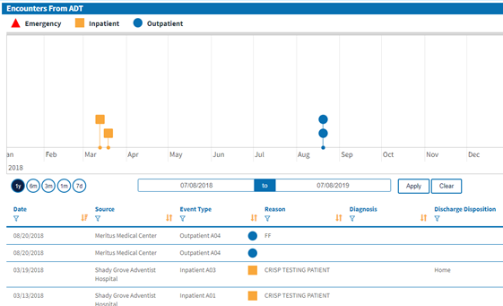
Data Moving Across the
Health Information Exchange
Additions in FY20
FEMS data, including 911 calls and transports in ADTs
COVID-19 labs from all sources
Image exchange
Provider Directory to support eReferral
Resources Under Development
SDOH Screening, referral, and follow-up
Consent management
Notes:
Core services designed to help promote continuity of care: Admit-discharge-transfer alerts; Lab results; Provider Directory; Image exchange

Slide 9
Not Yet Participating in the DC HIE?
Participate in the HIE Connectivity Program:
The DC HIE connectivity program provides education, training, and enrollment to the DC HIE. The DC HIE Connectivity Program provides users with benefits to optimize your EHR workflow, access care team data, and improve transitions of care.
Who Is Eligible:
Through 2021, all Medicaid-enrolled providers who submit at least 100 claims to DHCF in a year are eligible for HIE Connectivity technical assistance, which covers connectivity fees at no cost to the provider
Notes:
TAs can assist with review of telehealth options and workflow

Slide 10
SUD Provider Capacity Grant
Needs Assessment (DCPCA/JSI)
DATAWits Upgrades
Consent Management System Grant
Integrated Care Technical Assistance
Department of Health Care Finance |

