Slide 1
UMC Status Update
May Status Meeting to the OCFO & DHCF
5/23/17

Slide 2
Agenda
Review of Budget Gap Initiatives
  Hospital-wide initiatives
  Revenue Cycle initiatives
Review 3-year financial proforma and the underlying revenue and expense assumptions
APPRENDIX: March and April Performance Data

Slide 3
Hospital Initiatives
 | Initiative | Original Date | Target Date | Completion Date | Action Owner | Status
1 | Implement InterQual Guidelines | 4/30/17 | 5/26/17 |  | CEO/IT | InterQual has been deployed and the initial set of super users trained; however the s/w requires IE 11 web browser which is being deployed throughout the hospital
2 | Physician training on InterQual, Observation, Admission Certification, two midnight rule / medical necessity, and Meditech deployment | 5/12/17 | 6/15/17 |  | Case Mgmt / HIM / IT | Physician training continues: 2-midenight rule and Observation: online informational training module & Chief of Staff mandatory clinical documentation training InterQual in process Meditech admission/2-midnight certification configuration
3 | Hire scribe for immediate need for physician documentation | 4/17/17 |  |  | CEO / Dr. Craig | PO signed; positions being recruited
4 | Implement voice recognition for physician documentation (Upon implementation, this will eliminate/significantly reduce scribes) | 9/30/17 |  |  | IT/Dr. Craig | IT implementation vendor selection completed. Next step – develop implementation timeline.
5 | Accountability and monitoring of physician contracts | Continuous |  | On-going / continuous monitoring | David/Dr. Craig | Current contracts for the Hospitalists and ED Services are being updated with additional quality & performance metrics – target date of 6/30/17 Plan to develop and release RFP for Hospitalists & ED Services this summer

Slide 4
Hospital Initiatives cont.
 | Initiative | Original Date | Target Date | Completion Date | Action Owner | Status
6 | Placing patients in the correct level of care | Immediate |  | On-going / continuous monitoring | Case Mgmt | Expanded morning rounds between Hospitalist and Case Mgmt to focus of appropriate level of care for patients Permanent solution expected mid summer once case mgmt is 24/7 with staffing agency resources
7 | Training of RN/Providers on Observation Criteria | 5/12/17 | 6/30/17 |  | Maribel | Physicians training on-going ED Nurses will be trained via annual competency modules
8 | Implement Case Management in the Emergency Room 24/7 | Immediate | 6/1/17 |  | David | Solicited proposals from 3 vendors; selected RSI (staffing agency); PO for FY17 approved by Finance Committee and expected to be approved by the full Board on 5/24/17. Interviewing Director candidates on 5/24/17.
9 | Training of Case Managers and Social Workers | 5/12/17 | 6/16/17 |  | Adam | Employee level metrics and being developed and the corresponding training to ensure effectiveness and efficiency will be conducted
10 | Case Management assigned to direct admission and surgery department | 4/17/17 |  |  | Adam | Included in the staffing agency headcount
11 | Reduce Length of Stay | Continuous |  |  | Adam/Dr. Craig | Extended stays decreasing; over the past 5 days 12-13 patients with stays of 10+ days (40% of patient days) v. 20-25 patients (70+% of patient days)
12 | Improve skill mix in SNF | 7/31/17 |  |  | Maribel | On plan. Currently 17 Medicare patients; 115 census (14.8%)

Slide 5
Hospital Initiatives cont.
 | Initiative | Original Date | Target Date | Completion Date | Action Owner | Status
13 | Collaborate to implement hospital clinic visit billing | 7/31/17 |  |  | Billy | On Plan. Initial stakeholder meeting held 5/16
14 | Implement hospital based clinic visit billing | 7/31/17 |  |  | Billy | On Plan. Initial stakeholder meeting held 5/16
15 | Develop/revise charge ticket & define charge capture process for Clinic Visits | 7/31/17 |  |  | Dr. Dennis/Billy | On Plan. Initial stakeholder meeting held 5/16
16 | Create Emergency Room triage and workflow process | 4/18/17 |  | 4/18/17 | David | Implemented best practices & streamlined processes to decrease overall ED LOS and improve patient experience. EMS off-loading reduced from ~29 mins in Jan-Apr to 17 mins in May (MTD). Need to continuously track effectiveness
17 | Institute disposition nurse in Emergency Room | 5/15/17 |  |  | Maribel | CEO & CFO finalizing paperwork
18 | Initiate communication with Payors to re-negotiate all Master Agreements | 4/17/17 | 6/16/17 |  | David B & David T | Prioritizing current agreements and outreach strategy / timeline
19 | Provide AmeriHealth Master Agreement(s) to Legal for review & red line | 5/31/17 |  |  | CEO/David | Outpatient pricing still being finalized. All other terms agreed upon.
20 | Make business decision to enter into new and/or revised Payor Master Agreement(s) | 4/30/17 | 6/16/17 |  | CEO | See #18

Slide 6
Hospital Initiatives cont.
 | Initiative | Original Date | Target Date | Completion Date | Action Owner | Status
21 | Evaluate all outsourced vendor contracts to quantify savings | 8/31/17 |  |  | David | Completed: Talen Energy Retail, 2-May-2017, $40,000.00 Ortho Clinical (Lab supplies), 30-Apr-2017, $228,006.00 Crothall (Linen), 26-May-2017, $22,000.00 In-Process: Anesthesia - ~$40,000 Tenant Leases - ~$140,000
22 | Evaluate supply chain department and develop hospital-wide supply monitoring program | 5/31/17 | 6/30/17 |  | David | Working with vendor to transition GPO services New Materials Director starts 6/26/17
23 | Evaluate physical therapy contract | 4/24/17 | 6/30/17 |  | David | Initial meetings conducted with the vendor. Developing applicable metrics and performance monitoring plan.
24 | Evaluate the need for all physical therapy orders | 4/24/17 | 6/30/17 |  | Dr. Craig | Evaluation being performed
25 | Prepare Service Line Proforma (OCFO) by 4/30/2017 & Develop corrective strategies for underperforming programs | 5/31/17 | 6/15/17 OCFO 7/15/17 |  | CEO/David | Initial proformas analysis performed by the CFO identified problems with system data.

Slide 7
Hospital Initiatives cont.
 | Initiative | Original Date | Target Date | Completion Date | Action Owner | Status
26 | Service Line growth plan(s) | 7/28/17 |  |  | Dr. Craig/Dr. Morrow/Adam/David | See #25 Service Line Proformas
27 | Identify and document CEO's strategy to increase/maintain sustainable volumes | 6/30/17 |  |  | CEO | On Plan / working with department stakeholders
28 | Purchase and Implement phone system to increase Outpatient appointments | 4/30/17 | 6/16/17 |  | David/IT | Implementation of an ACD (automatic call distributor) is being deployed to distribute incoming calls to agents. Phone tree has been designed and the system will be configured.
29 | Purchase and implement HIM 3M revenue cycle software | 6/30/17 |  |  | CEO/HIM/CFO/IT | Contract is with Legal for review; CIO will develop an implementation timeline once contract is signed so he can plan IT resources
30 | Evaluate the need for Gastroenterology orders | 4/17/17 | 6/16/17 |  | Dr. Craig | Initial conversations with physicians indicated this is not an issue; however, a report is being developed to quantify how many patients are receiving GI orders within 1-2 days of discharge

Slide 8
Revenue Cycle Initiatives
 | Initiative | Original Date | Target Date | Completion Date | Action Owner | Status
1 | Implement Relay Health Clearance/AhiQa | 6/30/17 |  |  | Crystal/IT
2 | Hire Coding Manager and 5 additional coders | 6/30/17 |  |  | Jeremiah | Working with Agency until FT staff can be employed
3 | Transition outsourced coding vendor to in-house coding | 6/30/17 |  |  | Jeremiah | Working with Agency until FT staff can be employed
4 | Accomplish coding review to identify areas of opportunity | 6/30/17 |  |  | Jeremiah/CFO
5 | Implement Quality Assurance Team between coding and clinical documentation (CDI) | 6/30/17 |  |  | Jeremiah/Anna
6 | Hire Documentation and Quality Assurance Audit Manager and 1 additional Clinical Documentation Liaison | 6/30/17 |  |  | Anna
7 | Full assessment of CDI needs | 6/30/17 |  |  | Anna
8 | Accomplish 100% CDI review of Medicare and DC Medicaid records | 6/30/17 |  |  | Anna
9 | Expand CDI review to include DC Medicaid Managed Care | 6/30/17 |  |  | Anna
10 | Establish quality assurance billing audit process team | 6/30/17 |  |  | Jeremiah/ Veronica

Slide 9
Revenue Cycle Initiatives cont.
 | Initiative | Original Date | Target Date | Completion Date | Action Owner | Status
11 | Recruit Revenue Integrity Team (charge capture) | 6/30/17 |  |  | Amy
12 | Implement charge capture process for all revenue generating departments | 6/30/17 |  |  | Amy | To include review of ED Point system used for leveling
13 | Develop workplan to implement hospital clinic visit billing | 4/30/17 |  | 4/26/17 | Amy | Draft completed & circulated to stakeholders for comment
14 | Set-up Clinic Visit charge in CDM ensuring coding & pricing is accurate | 7/31/17 |  |  | Amy/Veronica
15 | Ensure necessary information is captured on bill for hospital-based clinic billing | 7/31/17 |  |  | Veronica/Amy
16 | Ensure proper language exists in Managed Care contracts for reimbursable services provided by hospital | 4/30/17 |  | On-going | Amy | Information provided for AmeriHealth
17 | Provide/review reimbursement rates to Payors & Hospital Administration for Managed Care contracting | 4/30/17 |  | On-going | Amy | Information provided for AmeriHealth

Slide 10
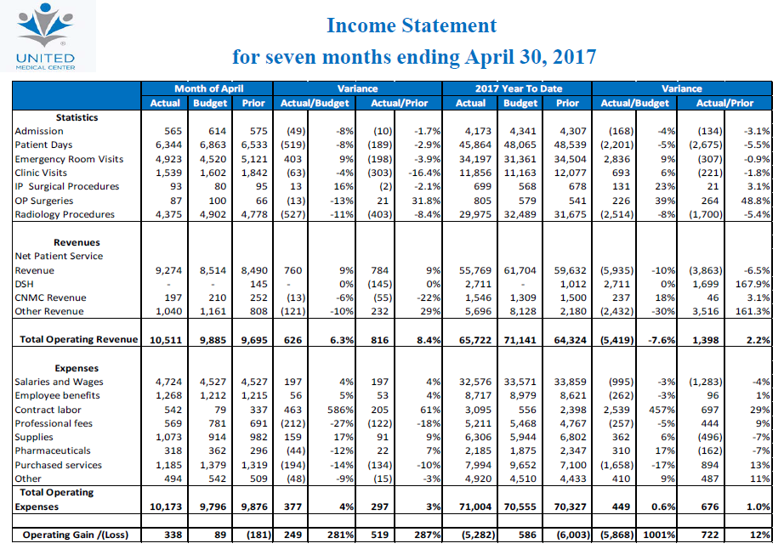
April Financials

Slide 11
3-year Financial Proforma
See additional handout

Slide 12
Appendix

Slide 13
Mar. Key Performance Indicators

Slide 14
Apr. Key Performance Indicators

